Slide 1
ASSIGNMENT Uber Supply-Demand Gap
by:
Prajwal Rao

Slide 2

Business Objective
Business Objective
The aim of analysis is to identify the root cause of the problem (i.e. cancellation and non-availability of cars) and recommend ways to improve the situation.
Approach
problems are systematically solved using EDA and data visualization.

Slide 3
Data exploration
6754 Unique Entries
2 Pickup Points types comprising of Airport, City.
5 continuous days 11th,12th, 13th,14th and 15th in the month of July

Slide 4
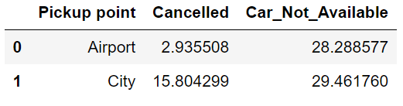
Data Analysis
Comparing the Pick points Based on the percent of Cancelled and Car not available Rides.
Car Not Available does not differ based on the pickup points and more cars needed generally in both the City and Airport.
Cancelled rides show a huge difference between Airport and City
- Assigning cars to close the demand gap in the airport first is the best ,due to the low cancel rate there.

Slide 5
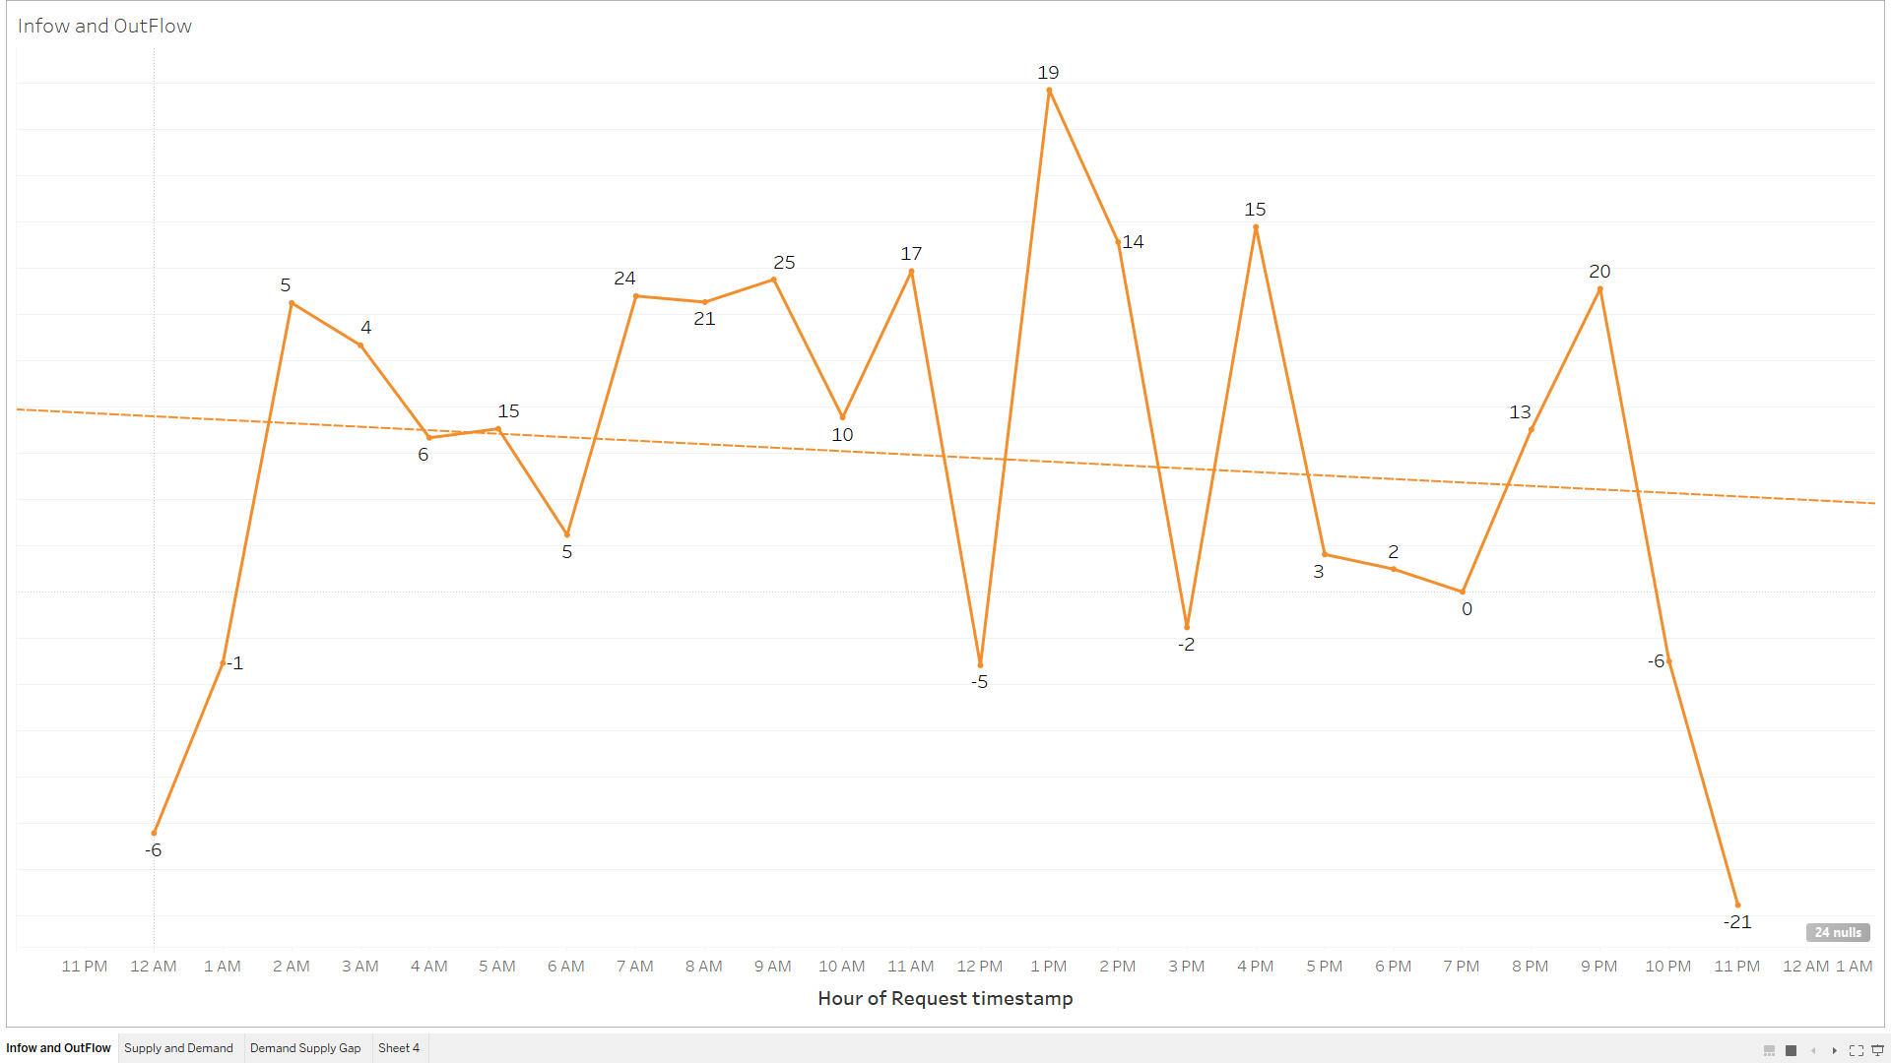
Hourly Analysis
Analysing the Hourly inflow and outflow of cars to and from the airport.
Analysis relives that the inflow of car increases through out the data, then decreases at night corresponding to the arriving planes.

Slide 6
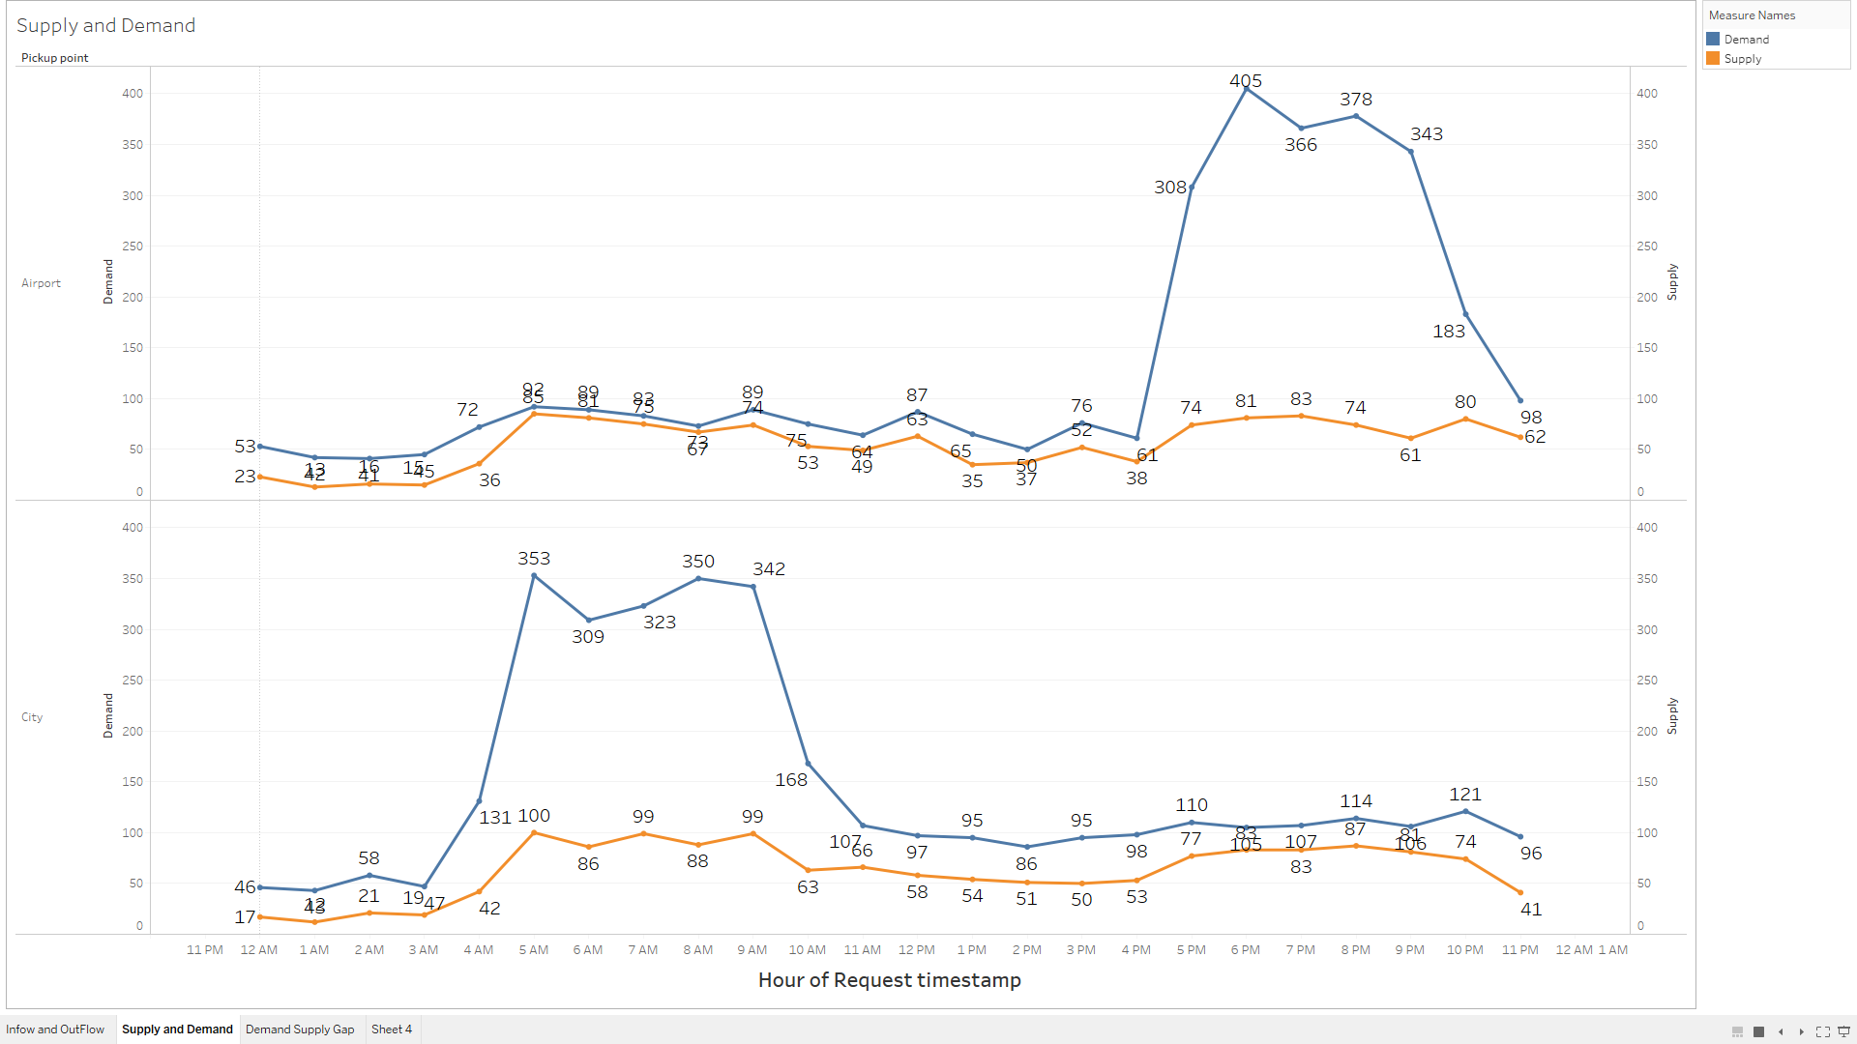
Demand and Supply Hourly Analysis
Airport has a huge spike in the demand at Night from 5pm to 11pm.
More drivers must be assigned at the night by providing proper incentives such as extra pay
City has a huge spike in demand in the early mornings when the day is starting from 04:00am to 11:00am.
More driver must be assigned at the night by adding proper incentives such as extra pay

Slide 7
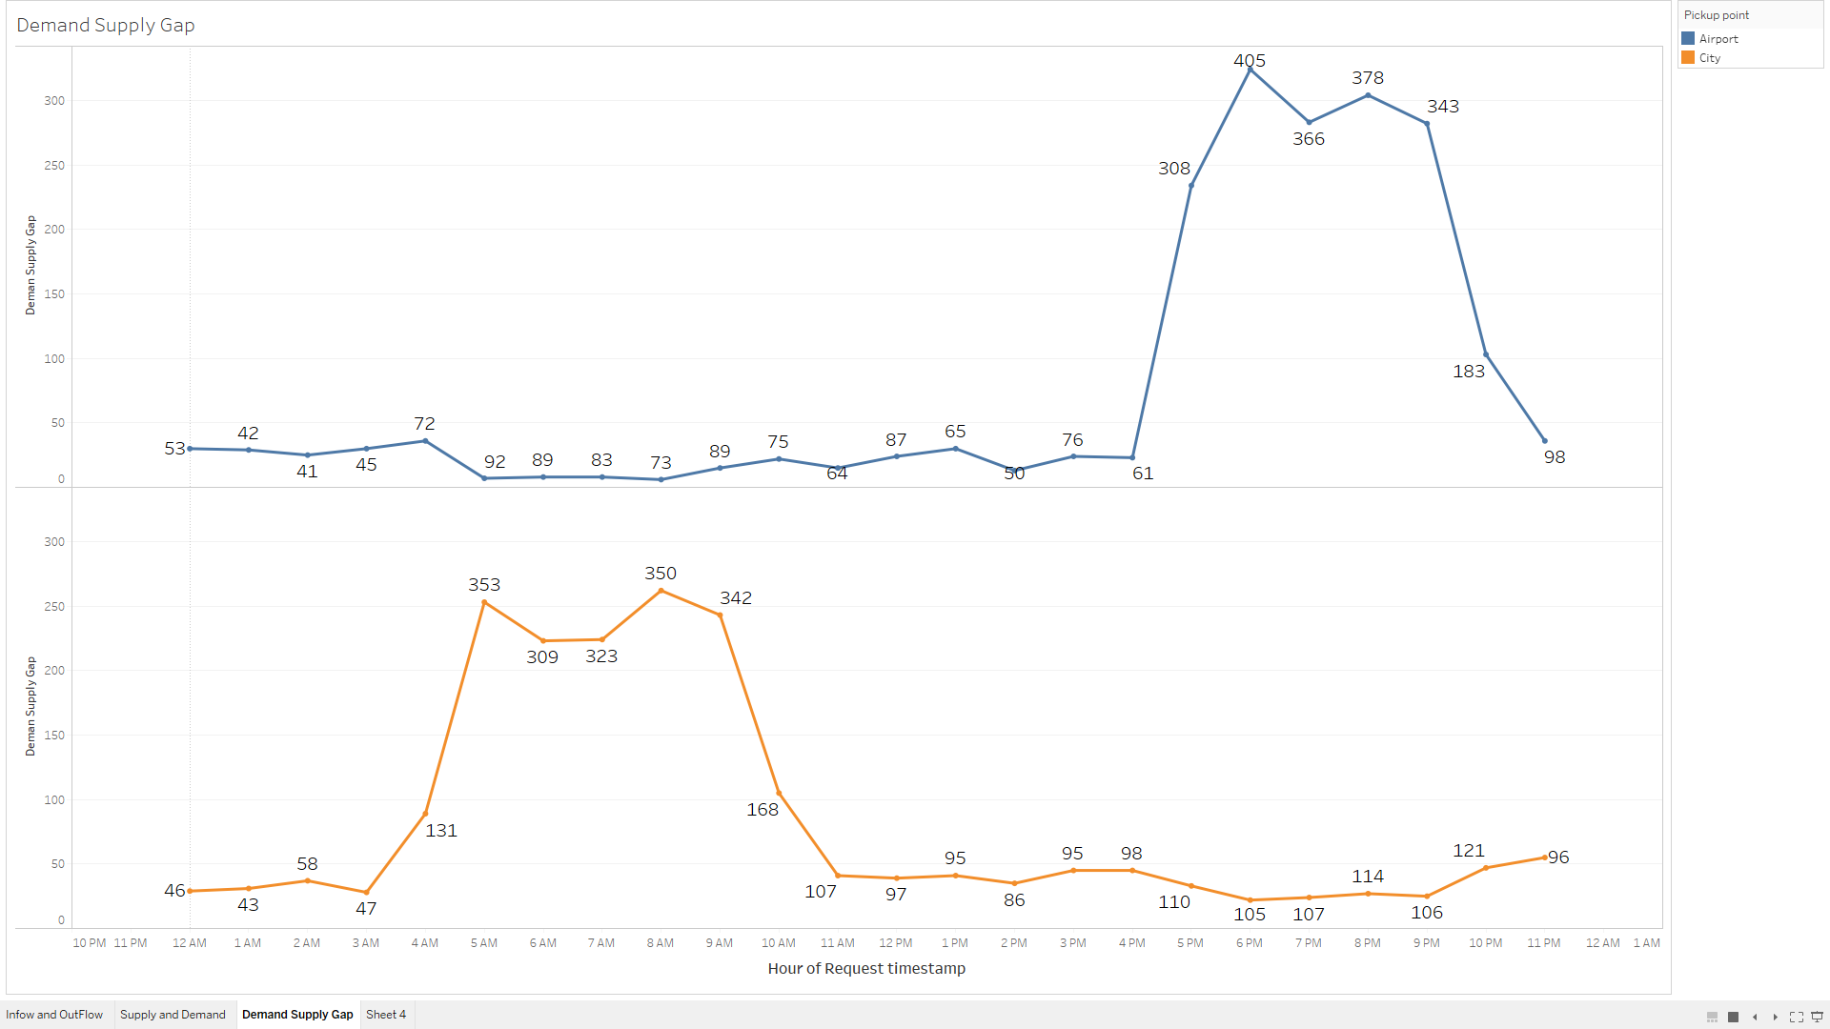
Demand and Supply Gap
As we can see there is always excess demand.
Increase no of cars at night at the Airport
Increase no of cars from 5am to11am at the City

Slide 8
Conclusion
After a through analysis we can draw the following conclusion :
Increase no of cars at night at the Airport from 5pm to 11pm.
Increase no of cars at the City from 04:00am to 11:00am.
Assigning car first to the airport as the riders have a lower cancellation rate but Very High Demand at night.

